Slide 1
Utility of 68Ga-FAPI and 68Ga-DOTANOC PET/CT in Gastrointestinal tumors.
dr. harish Nagaraj md, m.med (rd), fnm, mioi
Consultant radiologist & nuclear medicine specialist.

Slide 2
Disclosure
No financial disclosure or conflicts of interest with the presented material in this presentation.

Slide 3
Overview of Molecular Imaging in GI Tumors
GI tumors are molecularly heterogeneous
Different tracers highlight different biological pathways
Key tracers:
68Ga-FAPI → cancer-associated fibroblasts (CAF)
68Ga-DOTANOC → somatostatin receptor expression
18F-FDG → glucose metabolism
Goal: select the right tracer for the right tumor subtype

Slide 4
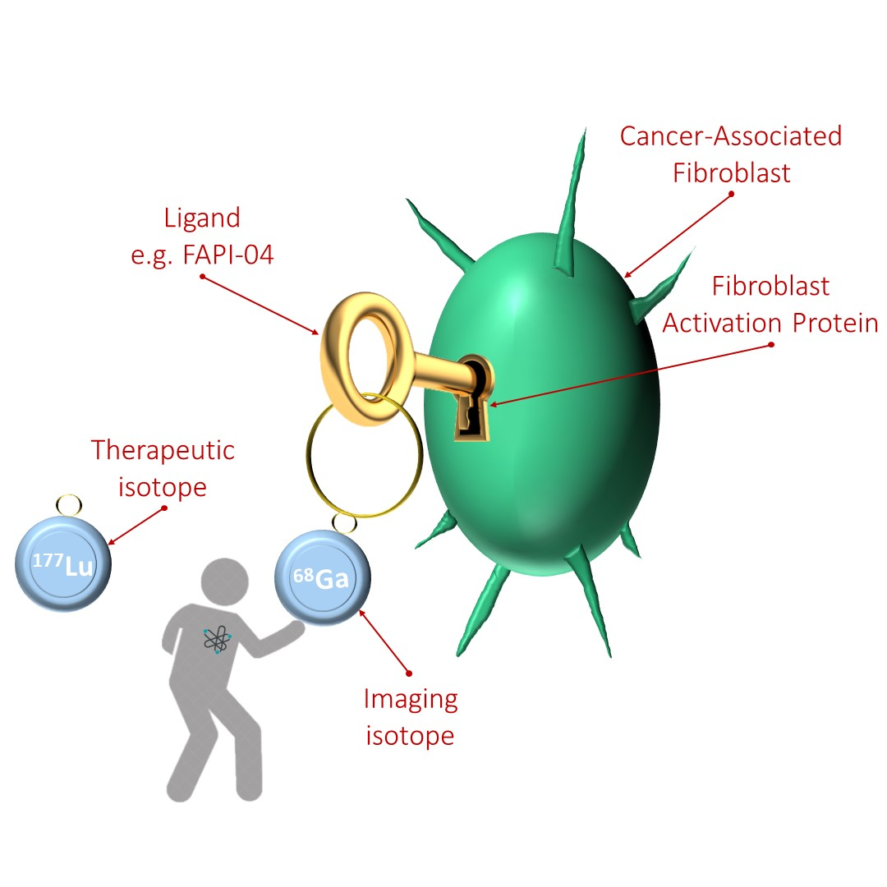
68Ga-FAPI: Mechanism & Advantages
Targets Fibroblast Activation Protein (FAP) → overexpressed in tumor stroma
Strengths: ✓ Very high tumor-to-background ratio ✓ Minimal physiological uptake in abdomen ✓ Useful in desmoplastic tumors ✓ Short waiting time (10–20 min)
Helpful for staging and detecting subtle peritoneal, mesenteric, and liver lesions

Slide 5
68Ga-FAPI in GI Tumors
High utility in:
Gastric adenocarcinoma → especially scirrhous/desmoplastic
Pancreatic ductal adenocarcinoma (PDAC) → stroma-rich
Colorectal cancer → superior for peritoneal carcinomatosis
Cholangiocarcinoma
Esophageal carcinoma Why? → These tumors have dense fibroblast-rich stroma, making FAPI highly sensitive.

Slide 6
Ca Gastric – FAPI For Staging

Slide 7
Ca Esophagus – FAPI Post treatment evaluation

Slide 8
Ca Rectum – FAPI For Staging

Slide 9
68Ga-DOTANOC in GI NETs
Targets Somatostatin Receptor subtype 2 (SSTR2), 3, and 5.
Best for well-differentiated neuroendocrine tumors (NETs) - DOTA High value in:
Gastric NETs
Pancreatic NETs
Small bowel NETs
Appendiceal NETs Provides: ✓ Sensitive whole-body staging ✓ Identifies candidates for PRRT (Lu-177 DOTATATE) ✓ High lesion detectability in liver and nodes

Slide 10
NET LIVER For Evaluation of disease status

Slide 11
NET SMALL BOWEL For Evaluation and Staging

Slide 12
NET COLON For Evaluation of disease status

Slide 13
68Ga-DOTANOC: Strengths in GI NETs
Excellent for Grade 1 & 2 NETs
Detects multifocal small bowel NETs not seen in CT
Superior for:
Lymph node metastases
Liver metastases (esp. low Ki-67)
Bone metastases
Crucial for treatment decision: PRRT vs SSA vs targeted therapy

Slide 14
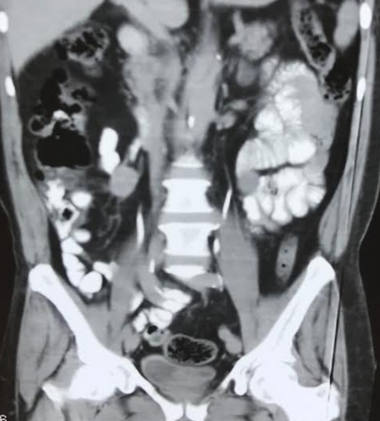
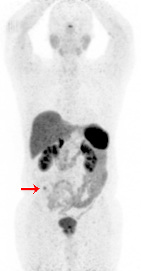
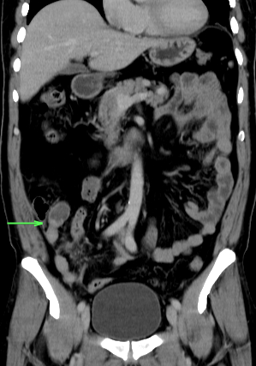
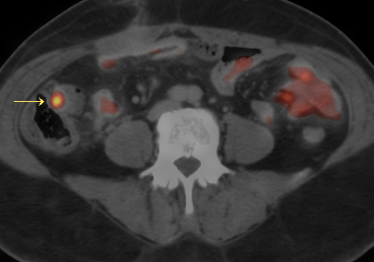
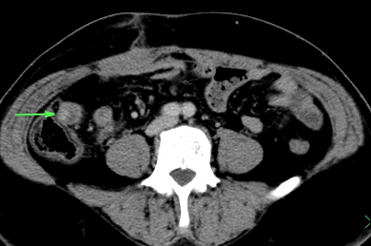
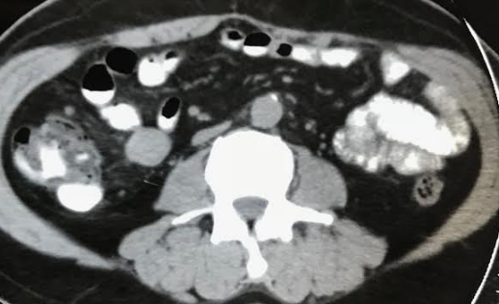
Recent surgical resection of mesenteric nodal NET mass, referred to localize the primary tumor.
Misr Radiology Center

Slide 15
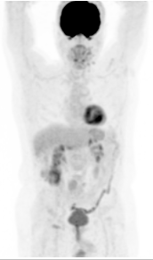
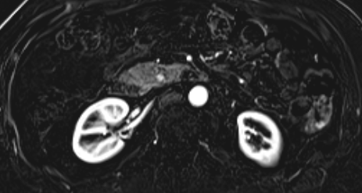
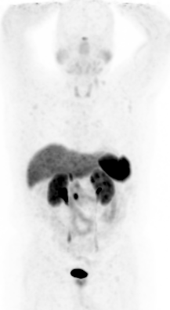
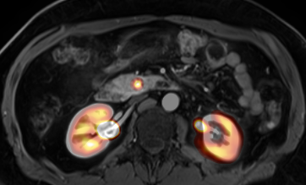
Patient presenting with hypoglycemia and suspected insulinoma.
Misr Radiology

Slide 16
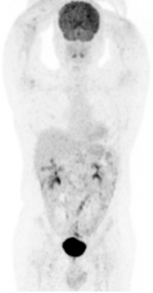
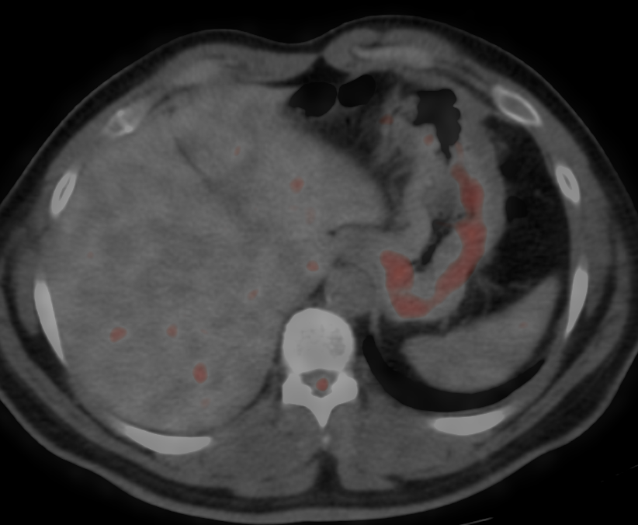
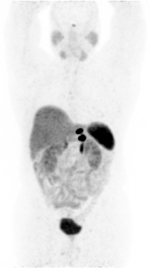
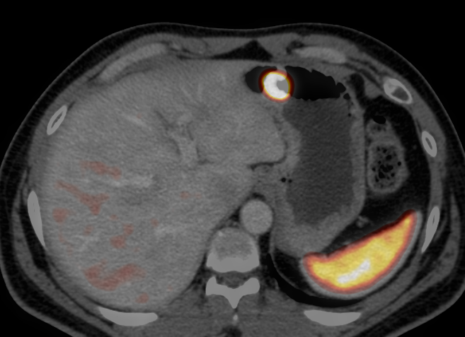
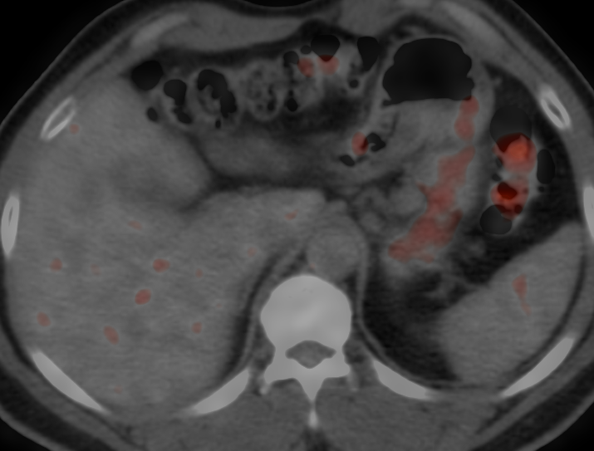
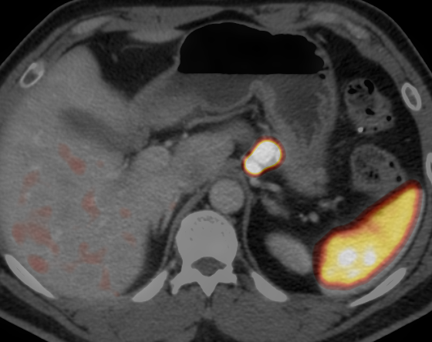
Patient presented with newly diagnosed gastric carcinoid and staging CT showed perigastric lymph nodes ? Metastatic.

Slide 17
Where FDG PET/CT Is Better Than DOTANOC
FDG has higher utility when NETs become aggressive or poorly differentiated. FDG PET/CT is superior in:
Grade 3 NETs
Neuroendocrine carcinomas (NEC)
High Ki-67 (> 20%)
Poor SSTR expression
Tumors with mismatch: FDG-positive, DOTANOC-negative → worse prognosis
Clinical importance: → FDG helps guide intensity of treatment, chemotherapy consideration, and prognosis.

Slide 18
FDG VS DOTANOC NET LUNG (high-grade) For Evaluation

Slide 19
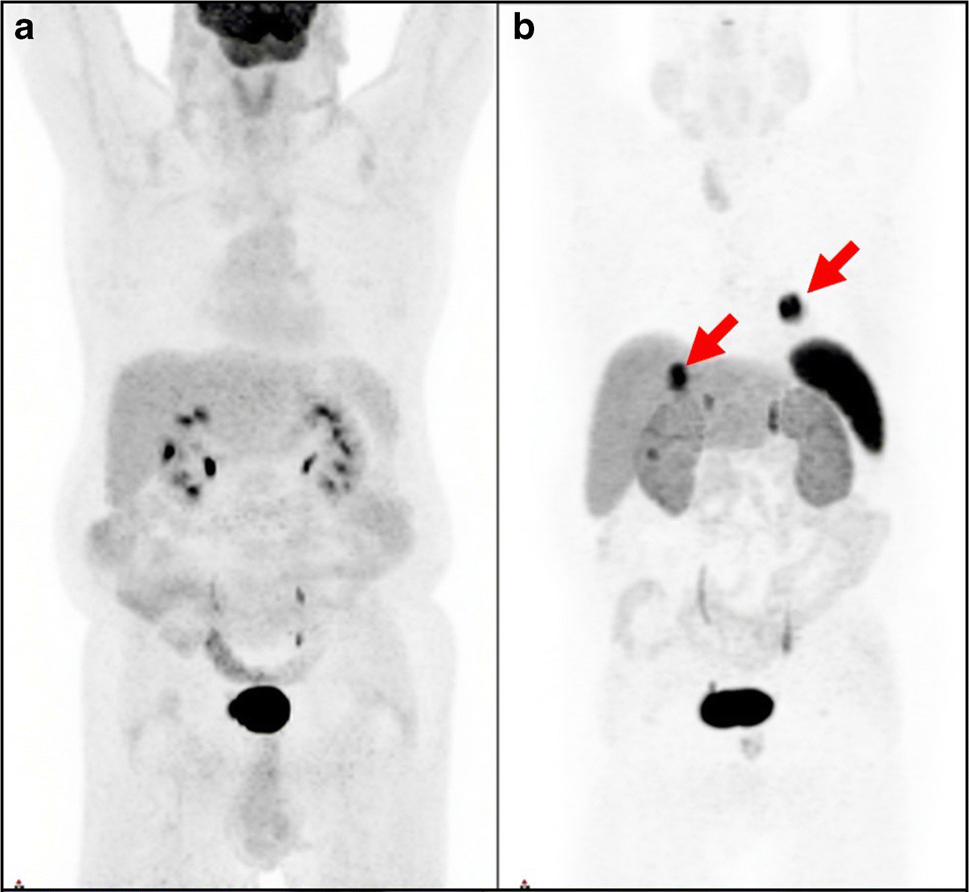
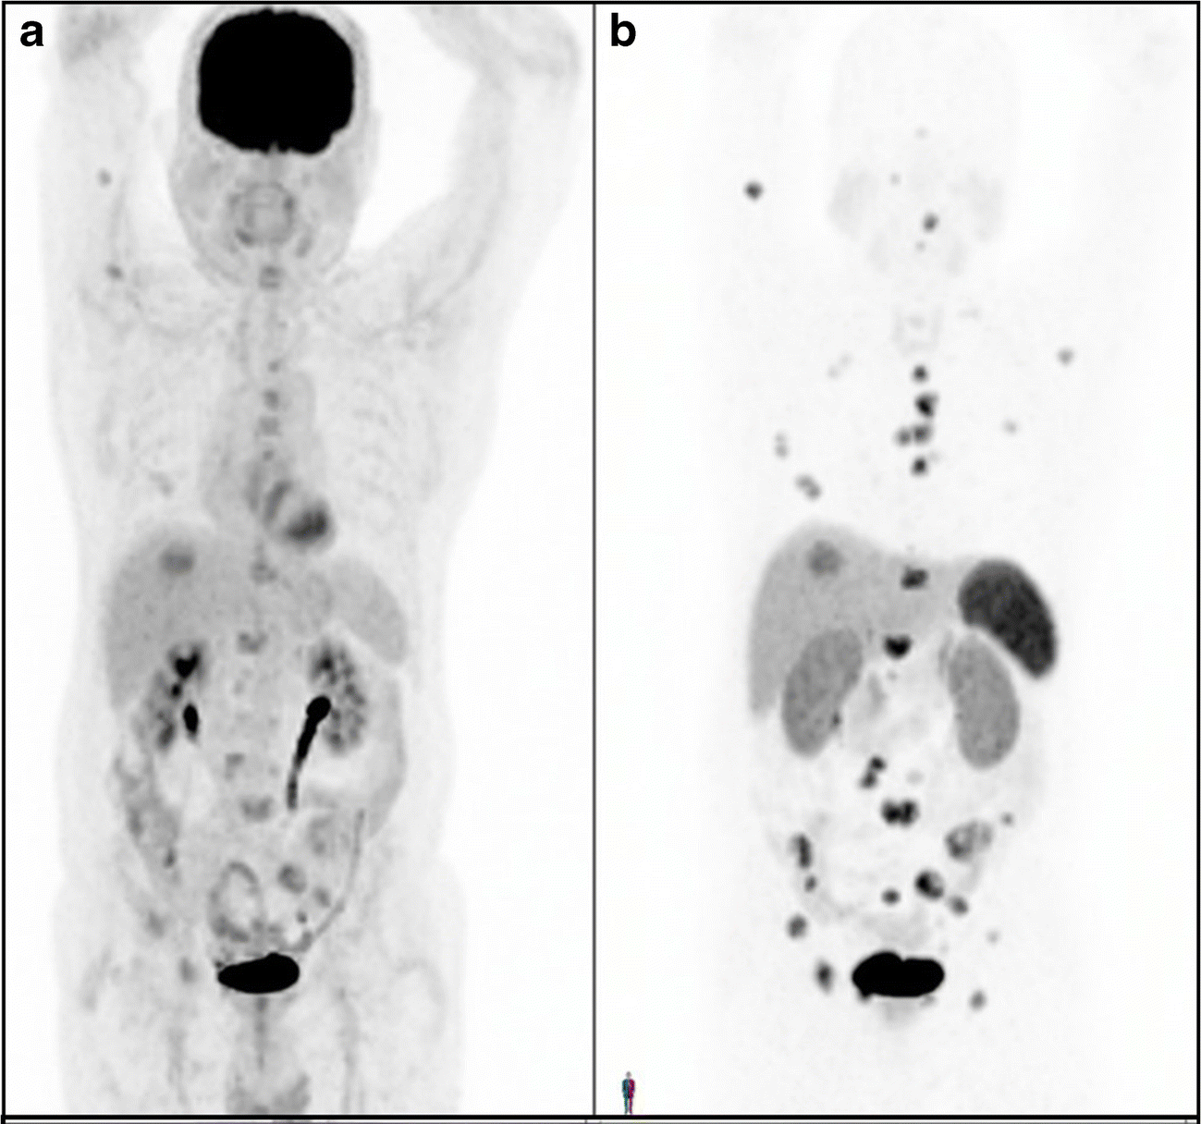
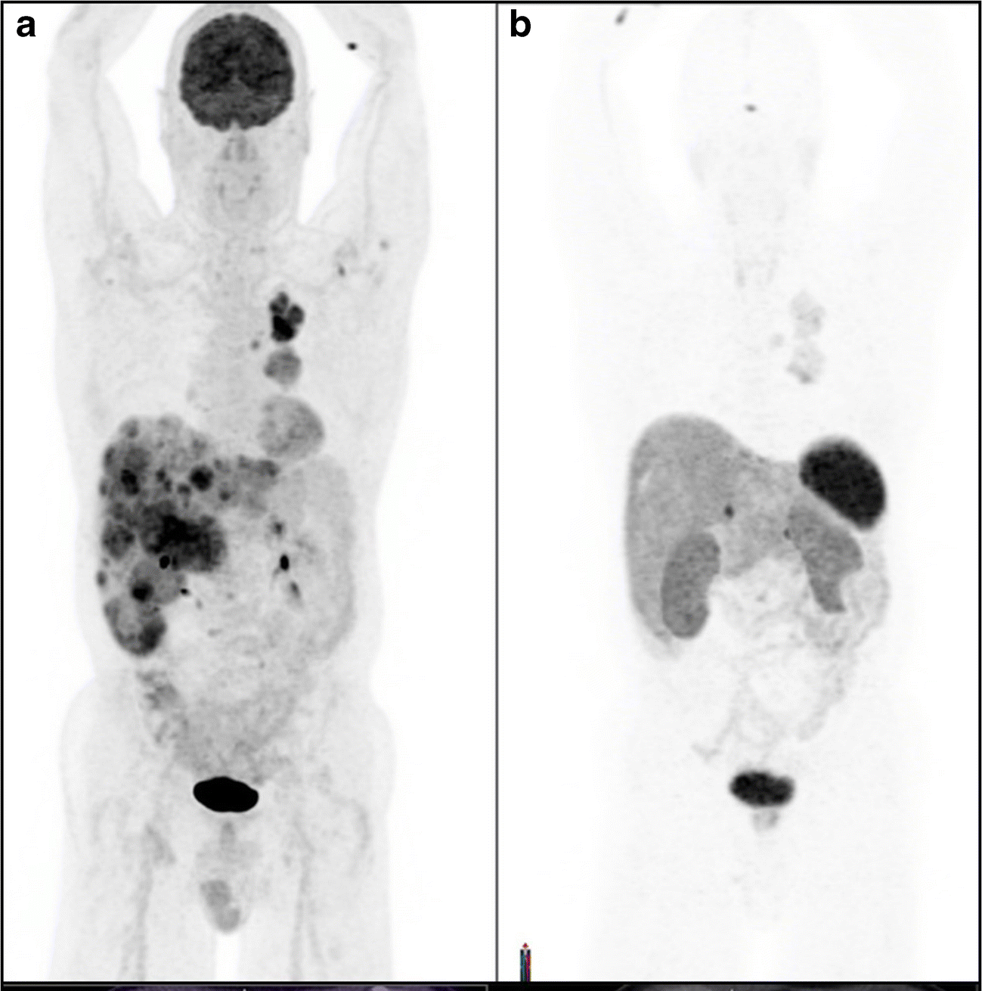
 | Well Differentiated |  |  | Poorly differentiated
Grade | Low (G1) | Intermediate (G2) | High (G3) | High
Ki-67% | <3 | 3-20 | >20 | >20
Prognosis | More Aggressive
¹⁸F-FDG-PET +ve
High glycolytic activity
Functional imaging
⁶⁸Ga-DOTATATE PET +ve
High SST receptors
Zidan, L. et al Theranostic implications of molecular imaging phenotype based on ⁶⁸Ga-DOTATATE PET/CT and ¹⁸F-FDG PET/CT. Eur J Nucl Med Mol Imaging (2021).
Notes:
Somatostine in the first line of treatment PRRT is after progression on somatostains analogues

Slide 20
Comparative Strengths in GI Cancers
Tumor Type | Best Tracer | Reason
NET Grade 1–2 | DOTANOC | SSTR expression
NET Grade 3 / NEC | FDG | High Metabolic actitvity
Pancreatic Adeno Ca | FAPI | Desmoplastic Stroma
Gastric Adeno Ca | FAPI | High FAP expression
Colorectal CA | FDG & FAPI | FDG for Mets; FAPI for peritoneal disease
Cholangio CA | FAPI | Stroma-rich

Slide 21
Hybrid Imaging Strategy: Complementary Use
FAPI + FDG → Comprehensive staging for GI adenocarcinomas
DOTANOC + FDG → NET “dual-tracer” approach for grading, prognosis, and therapy selection
Dual-tracer imaging improves: ✓ Tumor characterization ✓ Decision for PRRT ✓ Surgical planning ✓ Therapy response tracking

Slide 22
Key Takeaways
68Ga-FAPI excels in desmoplastic GI tumors and peritoneal metastases
68Ga-DOTANOC is gold standard for well-differentiated NETs
FDG PET/CT is superior in high-grade, aggressive, poorly differentiated tumors
Correct tracer selection improves: ✓ Staging ✓ Prognosis ✓ Treatment pathways ✓ Precision oncology outcomes
Molecular imaging is central to personalized GI cancer care

Slide 23
THANK YOU!

